Slide 1



SAFER Monitoring System: Development, draft indicators & next steps
Charles Parry, PhD
David Jernigan, PhD
Pamela Trangenstein, PhD
3rd Uganda Alcohol Policy Conference 23-25 Oct 2022

Slide 2
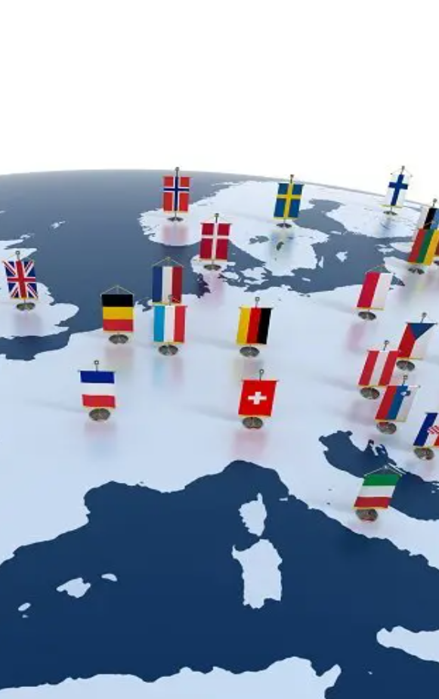
SAFER INDICATORS project
The goal of this project is to design metrics to compare the comprehensiveness and stringency of alcohol policies across countries and
over time within a country

Slide 3
Process to develop the safer monitoring system
Step 1
Identify SAFER domains
Step 2
Identify indicators falling in each domain
Step 3
Group indicators into dimensions
Step 4
Assign weights to indicators
Step 5
Create summary and composite indicators

Slide 4
indicators, DIMENSIONS, AND DOMAINS
DOMAINS: 5 SAFER policies + alcohol consumption and alcohol-related harms
DIMENSIONS: Groups of related indicators that fall within a given domain
INDICATORS: Individual data point
Breadth
Specificity
To identify indicators we drew on WHO reports, meeting reports, project reports & publications

Slide 5
EXAMPLE OF indicators, DIMENSIONS, AND DOMAINS
Drink-driving counter-measures
BAC limits
Max BAC for general population
Max BAC for young/novice drivers
Enforcement
RBT
Max BAC for motorcycles
Max BAC for professional drivers
Sobriety checkpoints
Domain
DIMENSIONs
weights
INDICATORs

Slide 6



Types of indicators
TYPES of indicators
core
expanded
implementation
Required indicators that describe the policies or current conditions
Optional indicators that describe the presence/absence of policies, levels of policies, or current conditions
Required indicators that measure policy implementation, e.g., enforcement, funding, and availability of equipment/supplies

Slide 7
SAFER INDICATORS
 | Domain | Dimensions | Core | Expanded (Optional) | Implementation
S | Availability | Regulatory structure
 |  | Temporal availability
 |  | Physical availability
 |  | Outlet practices
 |  | Home delivery
 |  | Unrecorded
A | Drink-driving counter-measures | BAC limits
 |  | Enforcement
F | Treatment | Screening & brief interventions
 |  | Advanced treatment
E | Advertising | Advertising restrictions
 |  | Youth protections
 |  | Enforcement & penalties
R | Pricing | Excise taxes
 |  | Affordability
 |  | Other pricing policies
Dimensions and types of indicators
Notes:
shading indicates that there is at least one indicator in that area

Slide 8
Weighting indicators
The meta-data* for Core and Implementation indicators contain a row for a weight
The weight is assigned based on the breadth of the evidence and policy effectiveness
The weight determines how many points are available for the indicator
1
2
3
4
5
Limited evidence base and/or less effective
Strong evidence base and/or highly effective

Slide 9
Weighting domains
pTS
Pricing policies
Availability
Marketing
Drink-driving counter-measures
SBIRT and treatment
30
25
20
15
10
Each domain also has a weight.
These weights also correspond to the breadth of the literature and evidence of effectiveness.
Domain weights factor into the calculation of the composite indicators.

Slide 10
Summary & COMPOSITE indicators
Summary indicators: Aggregate indicators by policy dimension and type of indicator
Composite indicators: Aggregate summary indicators by policy domain and type of indicator
Summary and composite indicators are calculated for:
The 5 SAFER areas
Core and implementation indicators only
Example: Summary indicators in the advertising domain
Dimensions | Summary indicator (SI)
Sub-dimensions | Core | Implementation
Advertising restrictions | SI 1 | SI 4
Youth protections | SI 2 | SI 5
Enforcement & penalties | SI 3 | SI 6
Composite indicator | SI 1 + SI 2 + SI 3 | SI 4 + SI 5 + SI 6
Notes:
SIs 1-3 would be combined to calculate the core composite indicator, and SIs 4-6 are combined to calculate the implementation composite indicator.

Slide 11
Domain-specific composite indicators
Composite indicators aggregate summary indicators by domain and type of indicator
Add the summary indicators that fall within a given domain
Divide to normalize the sum
The final score depends on the domain weight (10-30 points)
One core and one implementation composite indicator for each SAFER area.
 | Domain | Weight | Composite indicator
 | Domain |  | Core | Implementation
S | Availability | 25 | ✓ | ✓
A | Drink-driving counter-measures | 15 | ✓ | ✓
F | Treatment | 10 | ✓ | ✓
E | Advertising | 20 | ✓ | ✓
R | Pricing | 30 | ✓ | ✓

Slide 12
HIGH-LEVEL view of the safer monitoring system
 | Domain | Weight | Core | Implementation | Expanded | TOTAL
 | Consumption | — | 9 | 3 | 1 | 13
 | Harms | — | 6 | 0 | 4 | 10
S | Availability | 25 | 22 | 9 | 13 | 44
A | Drink-driving counter-measures | 15 | 7 | 9 | 1 | 17
F | Treatment | 10 | 3 | 5 | 5 | 13
E | Advertising | 20 | 44 | 13 | 1 | 58
R | Pricing | 30 | 7 | 1 | 7 | 15
 | TOTAL | 100 | 98 | 42 | 32 | 170

Slide 13
Example OF METADATA FOR AN indicator: Alcohol excise tax as the percent of the retail price of the most consumed alcoholic beverage
Metadata component | Description
Weight | ●●●●● 5/5
Indicator definition | This indicator is a calculation of how much alcohol excises (volumetric-specific, alcohol-content specific, and ad-valorem) contribute to the retail price of a most commonly sold package size of the most sold brand of the most consumed beverage type in the country. The "most sold brand" and the “most commonly sold package size” are determined based on national market share information. The retail price is the price charged (inclusive of all taxes) on a standard package of alcohol purchased at an off-premises alcohol outlet in the capital city. The percent of the retail price comprised by alcohol excise taxes represents the alcohol-specific tax burden of each alcohol purchase. If countries tax alcohol based on price (ad valorem), then the value for this indicator will be the same as the value of the indicator for the level of excise taxes on alcohol sales.
Sector | National authorities such as Customs and Excise Officers or the Ministry of Finance
Geographical coverage | National
Periodicity | Every year
Disaggregation | By sub-region
Annotation | This indicator measures tax burden and tax incidence, and it is superior to the tax paid per unit of alcohol indicator to measure how alcohol excise taxes distribute across income groups.
Indicator methodology | This indicator is calculated as 5=’tax>45%’; 4=’35%>tax<45%’; 3=’25%>tax<35%’; 2=’15%>tax<25%’, 1=’5%>tax<15%’, 0=’tax<5%’
Potential for error | There can be complexities in calculating the total taxes paid for each type of tax (e.g., sales tax vs. specific tax). Countries may wish to consider collaborating with an official from the Ministry of Finance to perform these calculations.

Slide 14

NEXT STEPS INCLUDE
Internal and external review of the indicators, summary indicators, and composite indicators
Revise the SAFER monitoring system as needed
Summarize the meeting with experts
Develop technical guide for using the SAFER monitoring system
Develop a plan for phased-in implementation of the SAFER monitoring system in Uganda and Nepal
GAPC Oct 2023 Cape Town
https://gapc2023.samrc.ac.za/

